Slide 1


Golang Poland Meetup #12 29 March 2021
Golang Warsaw #46
GoBridge

Slide 2
Speakers wanted
Please ask your colleages

Slide 3
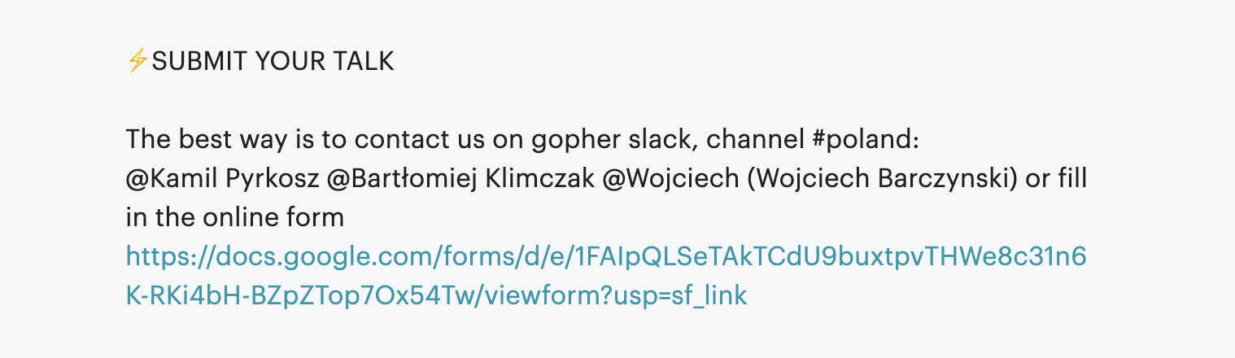
How to submit
Please ask your colleages

Slide 4
Questions?
Join channel #poland on gophers.slack.com.
https://invite.slack.golangbridge.org

Slide 5
Agenda
1. Into to Virtual Kubelet - featuring KIP - Paweł Bojanowski [Elotl]
2. Your announcements || Engineer lost & found
Grab coffee/beer break [5 min]
3. Don’t wait to communicate! A case for early abstraction - Ronna Steinberg

Slide 6
Ideas? Shall we do sth different/new?
It is your meetup.

Slide 7
Where to find us?
Twitter:
@golangwaw
@CracowGo
Slides: https://github.com/golangpoland/meetup_golang_warsaw

